Slide 1
Binary search tree

Slide 2
Binary Search Tree
Binary Search tree can be defined as a class of binary trees, in which the nodes are arranged in a specific order. This is also called ordered binary tree.
In a binary search tree, the value of all the nodes in the left sub-tree is less than the value of the root.
Similarly, value of all the nodes in the right sub-tree is greater than or equal to the value of the root.
This rule will be recursively applied to all the left and right sub-trees of the root.

Slide 3
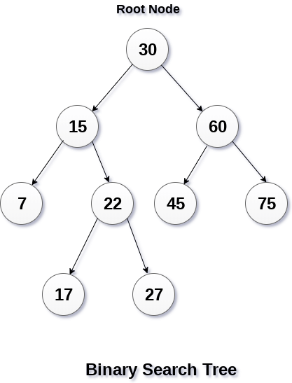

Slide 4
Advantages of using binary search tree
Searching become very efficient in a binary search tree since, we get a hint at each step, about which sub-tree contains the desired element.
The binary search tree is considered as efficient data structure in compare to arrays and linked lists. In searching process, it removes half sub-tree at every step. Searching for an element in a binary search tree takes o(log₂n) time. In worst case, the time it takes to search an element is 0(n).
It also speed up the insertion and deletion operations as compare to that in array and linked list.

Slide 5
Create the binary search tree using the following data elements.
43, 10, 79, 90, 12, 54, 11, 9, 50
Insert 43 into the tree as the root of the tree.
Read the next element, if it is lesser than the root node element, insert it as the root of the left sub-tree.
Otherwise, insert it as the root of the right of the right sub-tree.

Slide 6
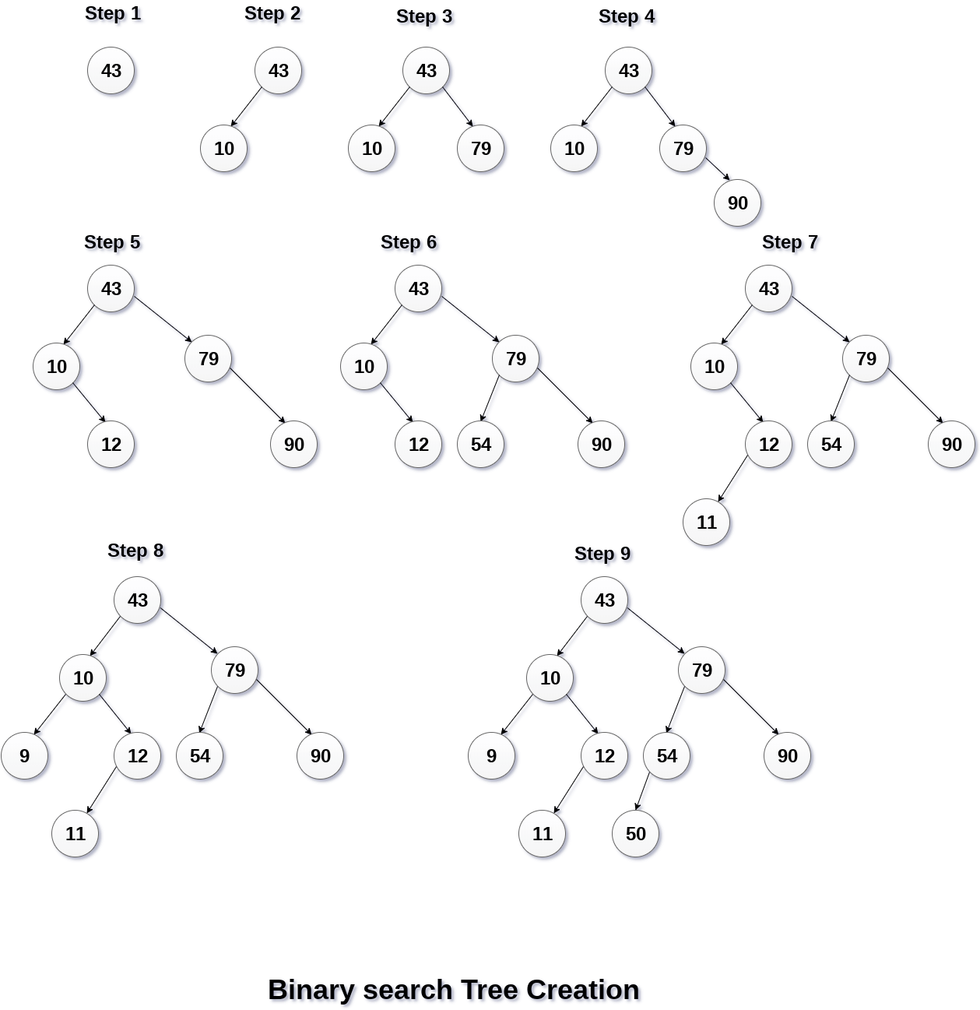

Slide 7
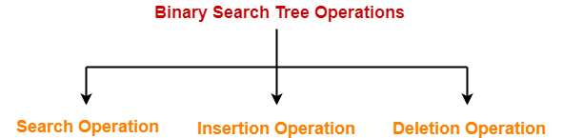
Operations on Binary Search Tree

Slide 8
1. Search Operation-
Rules-
For searching a given key in the BST,
Compare the key with the value of root node.
If the key is present at the root node, then return the root node.
If the key is greater than the root node value, then recur for the root node’s right subtree.
If the key is smaller than the root node value, then recur for the root node’s left subtree.

Slide 9
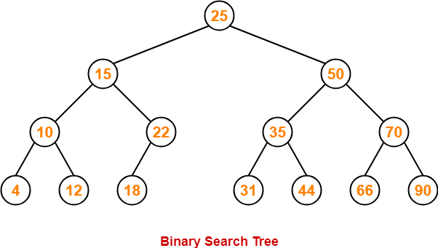
Example-
Consider key = 45 has to be searched in the given BST-

Slide 10
We start our search from the root node 25.
As 45 > 25, so we search in 25’s right subtree.
As 45 < 50, so we search in 50’s left subtree.
As 45 > 35, so we search in 35’s right subtree.
As 45 > 44, so we search in 44’s right subtree but 44 has no subtrees.
So, we conclude that 45 is not present in the above BST.

Slide 11
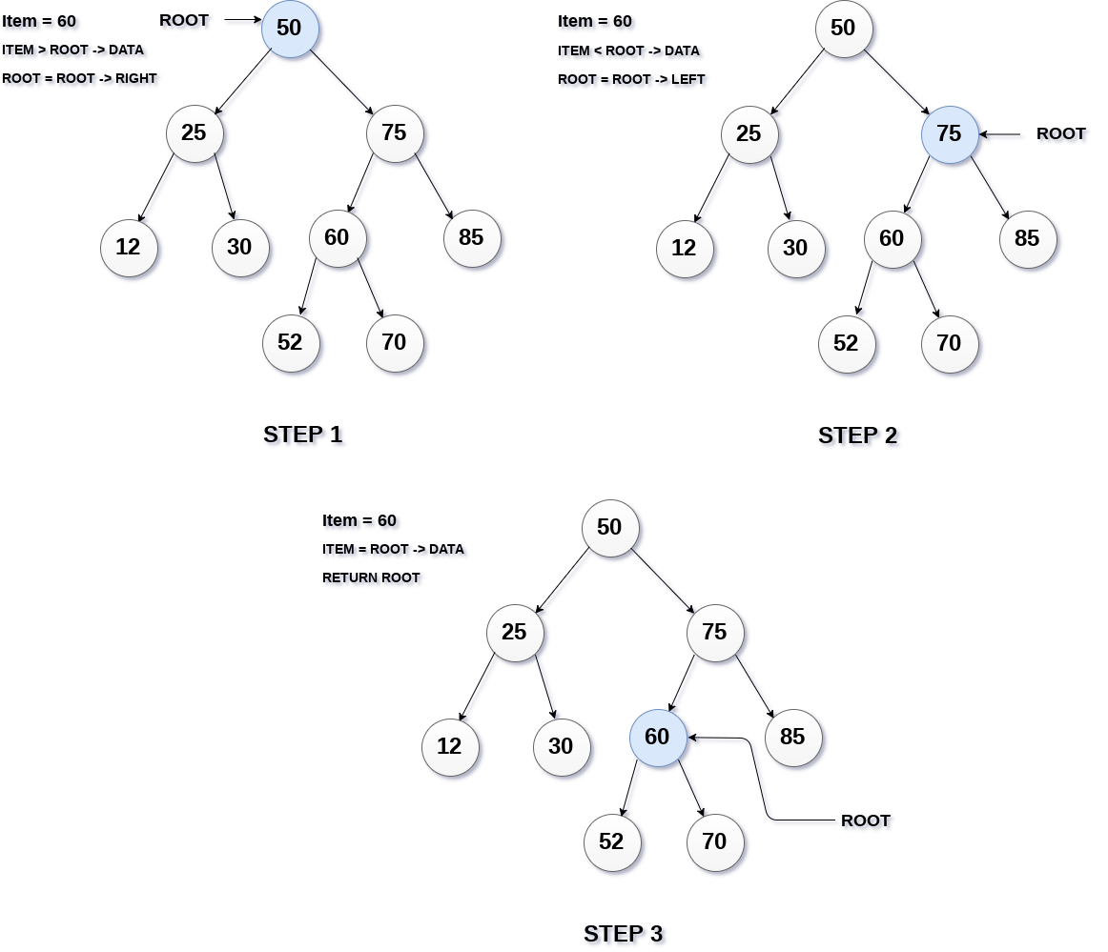

Slide 12
Algorithm:
Search (ROOT, ITEM)
Step 1: IF ROOT -> DATA = ITEM OR ROOT = NULL
Return ROOT
ELSE
IF ROOT < ROOT -> DATA
Return search(ROOT -> LEFT, ITEM)
ELSE
Return search(ROOT -> RIGHT,ITEM)
[END OF IF]
[END OF IF]
Step 2: END

Slide 13
Insertion
Insert function is used to add a new element in a binary search tree at appropriate location. Insert function is to be designed in such a way that, it must node violate the property of binary search tree at each value.
Allocate the memory for tree.
Set the data part to the value and set the left and right pointer of tree, point to NULL.
If the item to be inserted, will be the first element of the tree, then the left and right of this node will point to NULL.
Else, check if the item is less than the root element of the tree, if this is true, then recursively perform this operation with the left of the root.
If this is false, then perform this operation recursively with the right sub-tree of the root.

Slide 14
Insert (TREE, ITEM)
Step 1: IF TREE = NULL
Allocate memory for TREE
SET TREE -> DATA = ITEM
SET TREE -> LEFT = TREE -> RIGHT = NULL
ELSE
IF ITEM < TREE -> DATA
Insert(TREE -> LEFT, ITEM)
ELSE
Insert(TREE -> RIGHT, ITEM)
[END OF IF]
[END OF IF]
Step 2: END

Slide 15
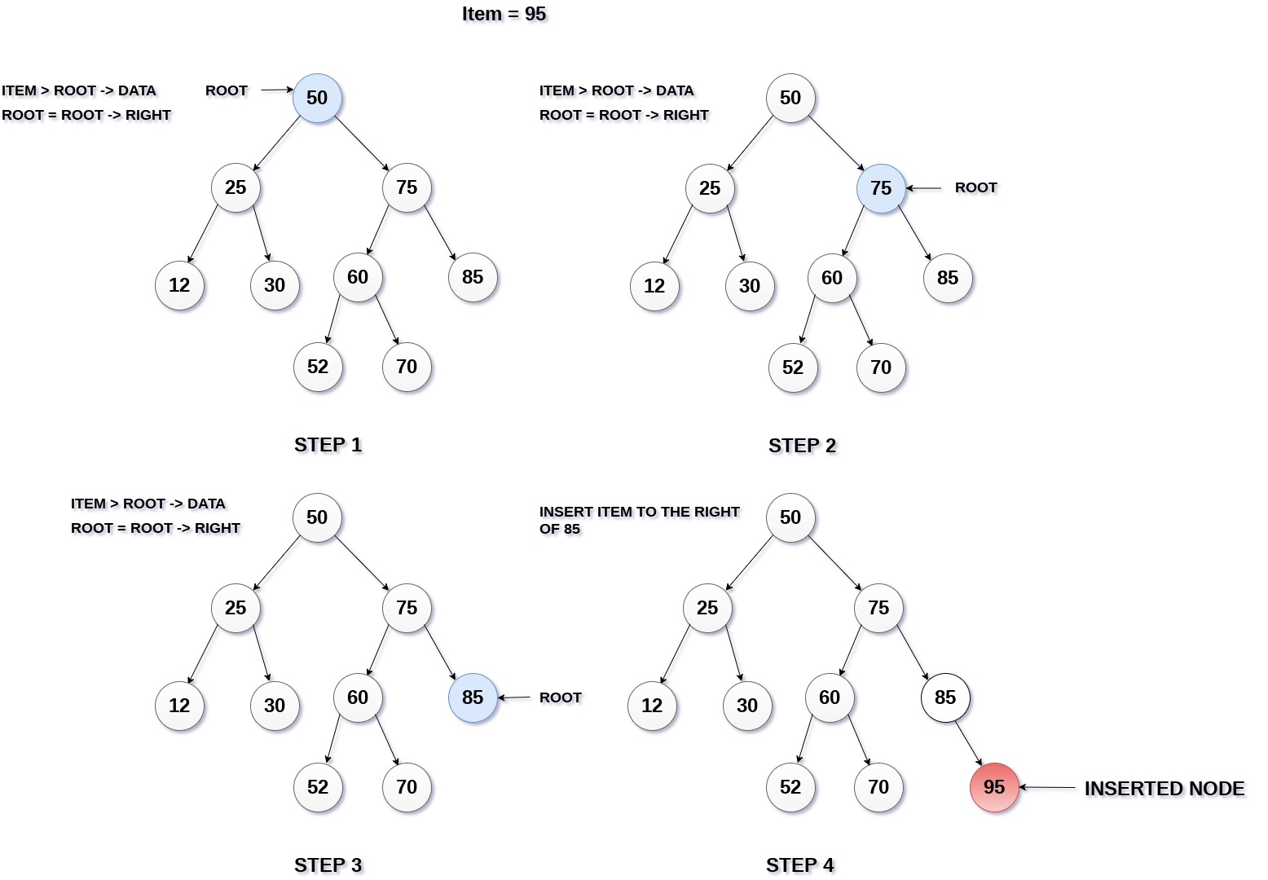

Slide 16
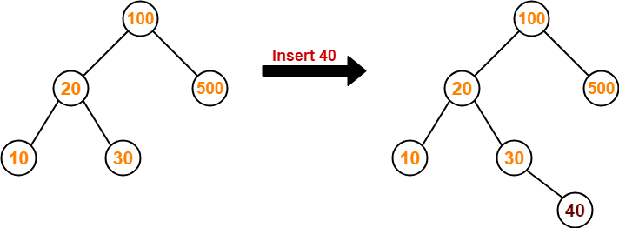
Consider the following example where key = 40 is inserted in the given BST-
We start searching for value 40 from the root node 100.
As 40 < 100, so we search in 100’s left subtree.
As 40 > 20, so we search in 20’s right subtree.
As 40 > 30, so we add 40 to 30’s right subtree.

Slide 17
3. Deletion Operation-
Deletion Operation is performed to delete a particular element from the Binary Search Tree.
Case-01: Deletion Of A Node Having No Child (Leaf Node)
Case-02: Deletion Of A Node Having Only One Child

Slide 18
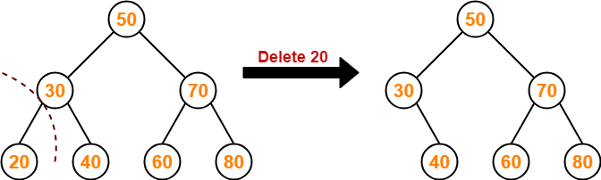
Case-01: Deletion Of A Node Having No Child (Leaf Node)-
Consider the following example where node with value = 20 is deleted from the BST-

Slide 19
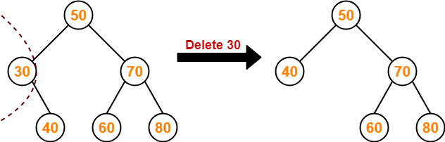
Case-02: Deletion Of A Node Having Only One Child-
Consider the following example where node with value = 30 is deleted from the BST-

Slide 20
Case-02: Deletion Of A Node Having Two Children-
A node with two children may be deleted from the BST in the following two ways-
Method-01:
-Visit to the right subtree of the deleting node.
-Pluck the least value element called as inorder successor.
-Replace the deleting element with its inorder successor.

Slide 21
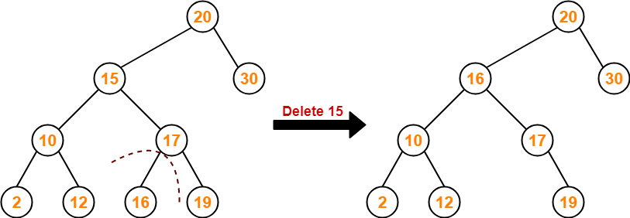
Example-
Consider the following example where node with value = 15 is deleted from the BST-

Slide 22
Method-02:
-Visit to the left subtree of the deleting node.
-Pluck the greatest value element called as inorder predecessor.
-Replace the deleting element with its inorder predecessor.

Slide 23
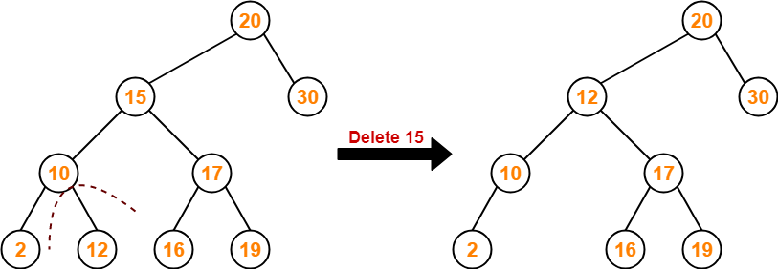
Consider the following example where node with value = 15 is deleted from the BST-

Slide 24
Algorithm
Delete (TREE, ITEM)
Step 1: IF TREE = NULL
Write "item not found in the tree" ELSE IF ITEM < TREE -> DATA
Delete(TREE->LEFT, ITEM)
ELSE IF ITEM > TREE -> DATA
Delete(TREE -> RIGHT, ITEM)
ELSE IF TREE -> LEFT AND TREE -> RIGHT
SET TEMP = findLargestNode(TREE -> LEFT)
SET TREE -> DATA = TEMP -> DATA
Delete(TREE -> LEFT, TEMP -> DATA)
ELSE
SET TEMP = TREE
IF TREE -> LEFT = NULL AND TREE -> RIGHT = NULL
SET TREE = NULL
ELSE IF TREE -> LEFT != NULL
SET TREE = TREE -> LEFT
ELSE
SET TREE = TREE -> RIGHT
[END OF IF]
FREE TEMP
[END OF IF]
Step 2: END

Slide 25
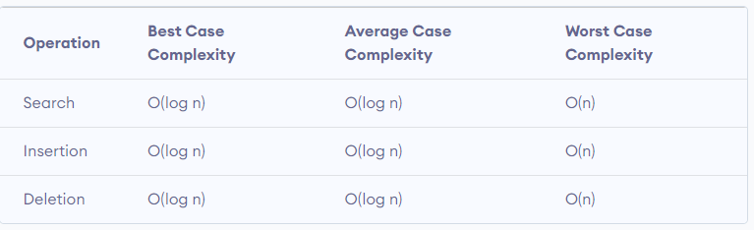
Binary Search Tree Complexities

Slide 26
Binary Search Tree Applications
In multilevel indexing in the database
For dynamic sorting
For managing virtual memory areas in Unix kernel

Slide 27
Finding min and max
In multilevel indexing in the database
For dynamic sorting
For managing virtual memory areas in Unix kernel

Slide 28
AVL Trees

Slide 29
AVL Tree-
AVL trees are special kind of binary search trees.
In AVL trees, height of left subtree and right subtree of every node differs by at most one.
AVL trees are also called as self-balancing binary search trees.
AVL tree is a self-balancing binary search tree in which each node maintains extra information called a balance factor whose value is either -1, 0 or +1.

Slide 30
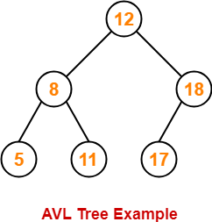
Example-
This tree is an AVL tree because-
It is a binary search tree.
The difference between height of left subtree and right subtree of every node is at most one.

Slide 31
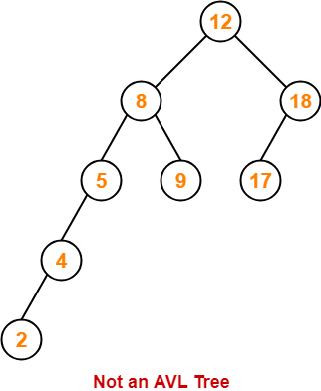
Following tree is not an example of AVL Tree-
This tree is not an AVL tree because-
The difference between height of left subtree and right subtree of root node = 4 – 2 = 2.
This difference is greater than one.

Slide 32
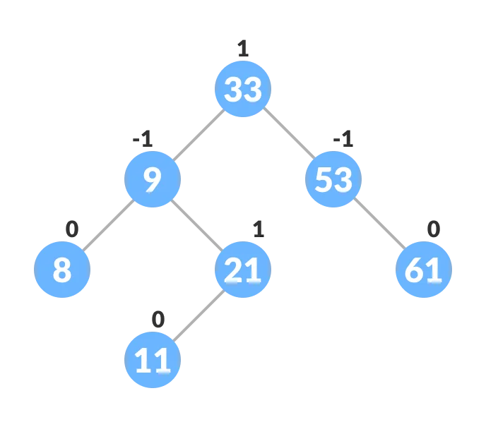
Balance Factor-
Balance factor of a node in an AVL tree is the difference between the height of the left subtree and that of the right subtree of that node.
Balance Factor = (Height of Left Subtree - Height of Right Subtree) or (Height of Right Subtree - Height of Left Subtree)
The self balancing property of an avl tree is maintained by the balance factor. The value of balance factor should always be -1, 0 or +1.
An example of a balanced avl tree is:

Slide 33
AVL Tree Operations-
Search Operation
Insertion Operation
Deletion Operation
After performing any operation on AVL tree, the balance factor of each node is checked.

Slide 34
There are following two cases possible-
Case-01:
After the operation, the balance factor of each node is either 0 or 1 or -1.
In this case, the AVL tree is considered to be balanced.
The operation is concluded.
Case-02:
After the operation, the balance factor of at least one node is not 0 or 1 or -1.
In this case, the AVL tree is considered to be imbalanced.
Rotations are then performed to balance the tree.

Slide 35
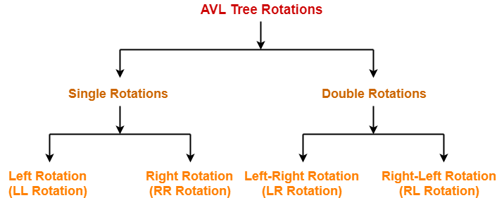
AVL Tree Rotations-
Rotation is the process of moving the nodes to make tree balanced.

Slide 36
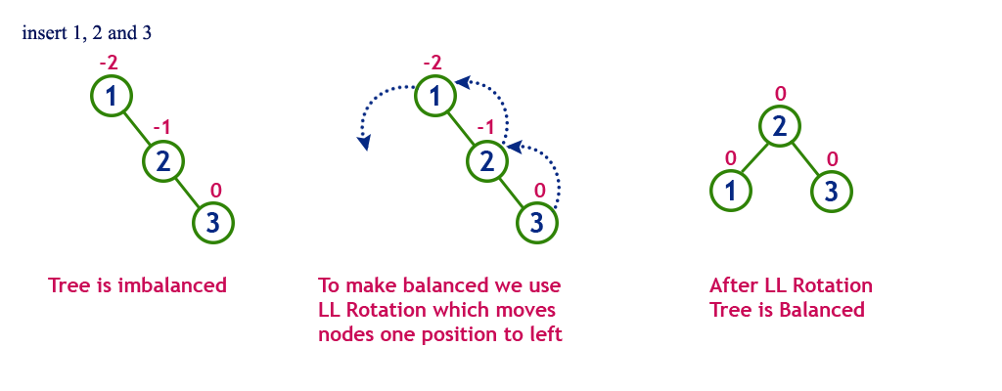
Cases Of Imbalance And Their Balancing Using Rotation Operations- Case I

Slide 37
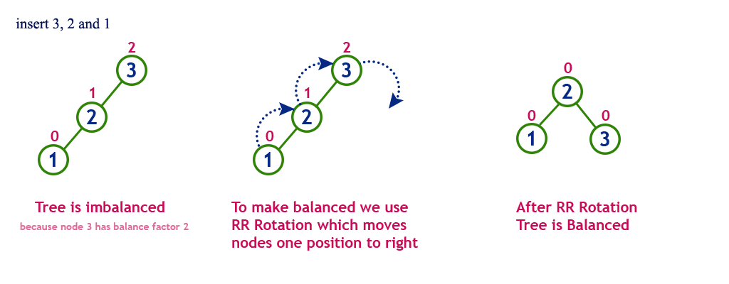
Case II-

Slide 38
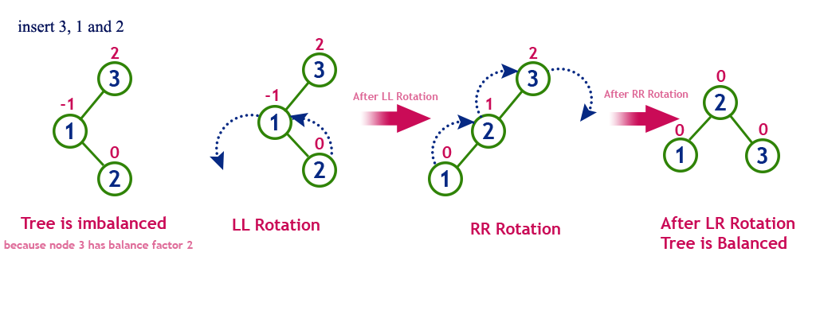
Case III-

Slide 39
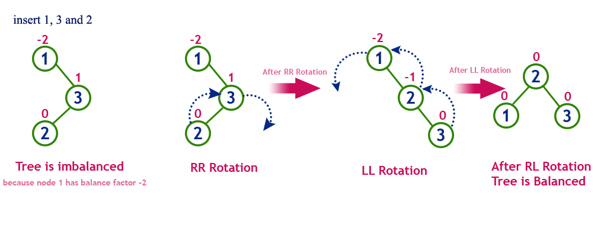
Case IV-

Slide 40
Operations on an AVL Tree
The following operations are performed on AVL tree...
Search
Insertion
Deletion

Slide 41
Search Operation on an AVL Tree
In an AVL tree, the search operation is performed with O(log n) time complexity. The search operation in the AVL tree is similar to the search operation in a Binary search tree. We use the following steps to search an element in AVL tree...
Step 1 - Read the search element from the user.
Step 2 - Compare the search element with the value of root node in the tree.
Step 3 - If both are matched, then display "Given node is found!!!" and terminate the function
Step 4 - If both are not matched, then check whether search element is smaller or larger than that node value.
Step 5 - If search element is smaller, then continue the search process in left subtree.
Step 6 - If search element is larger, then continue the search process in right subtree.
Step 7 - Repeat the same until we find the exact element or until the search element is compared with the leaf node.
Step 8 - If we reach to the node having the value equal to the search value, then display "Element is found" and terminate the function.
Step 9 - If we reach to the leaf node and if it is also not matched with the search element, then display "Element is not found" and terminate the function.

Slide 42
Insertion Operation on an AVL Tree
In an AVL tree, the insertion operation is performed with O(log n) time complexity. In AVL Tree, a new node is always inserted as a leaf node. The insertion operation is performed as follows...
Step 1 - Insert the new element into the tree using Binary Search Tree insertion logic.
Step 2 - After insertion, check the Balance Factor of every node.
Step 3 - If the Balance Factor of every node is 0 or 1 or -1 then go for next operation.
Step 4 - If the Balance Factor of any node is other than 0 or 1 or -1 then that tree is said to be imbalanced. In this case, perform suitable Rotation to make it balanced and go for next operation.

Slide 43
Deletion Operation on an AVL Tree
The deletion operation in AVL Tree is similar to deletion operation in BST. But after every deletion operation, we need to check with the Balance Factor condition. If the tree is balanced after deletion go for next operation otherwise perform suitable rotation to make the tree Balanced.

Slide 44
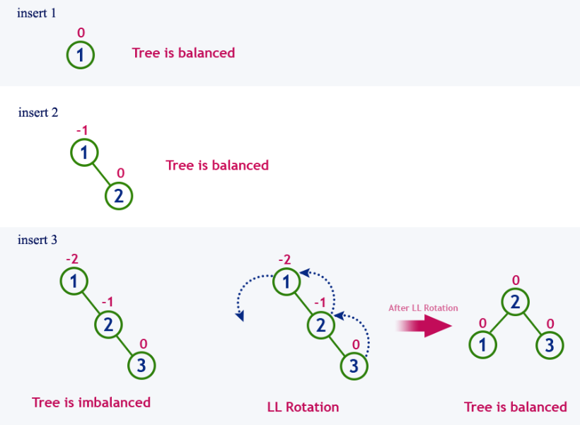
Example Insert numbers from 1 to 8

Slide 45
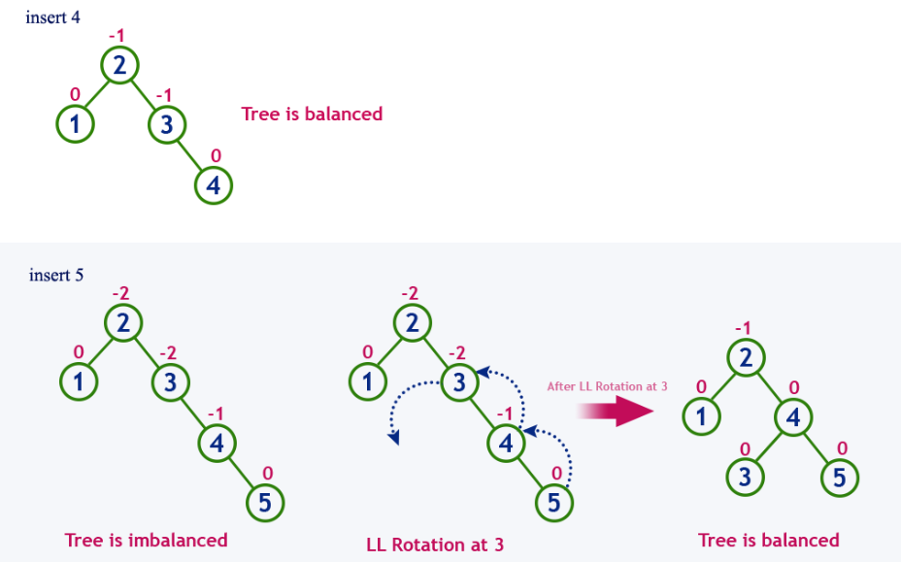
Example Insert numbers from 1 to 8

Slide 46
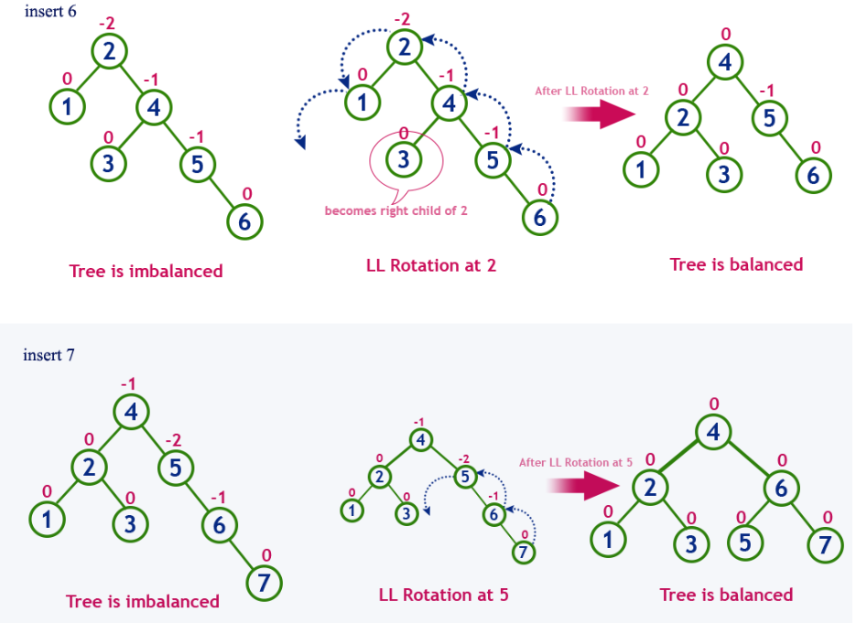
Example Insert numbers from 1 to 8

Slide 47
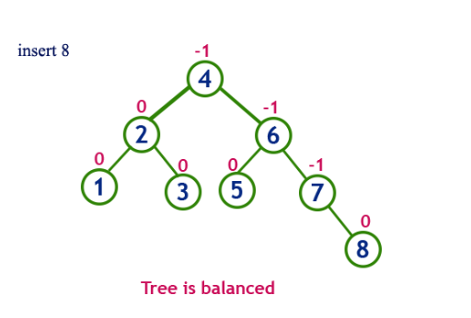
Example Insert numbers from 1 to 8

Slide 48
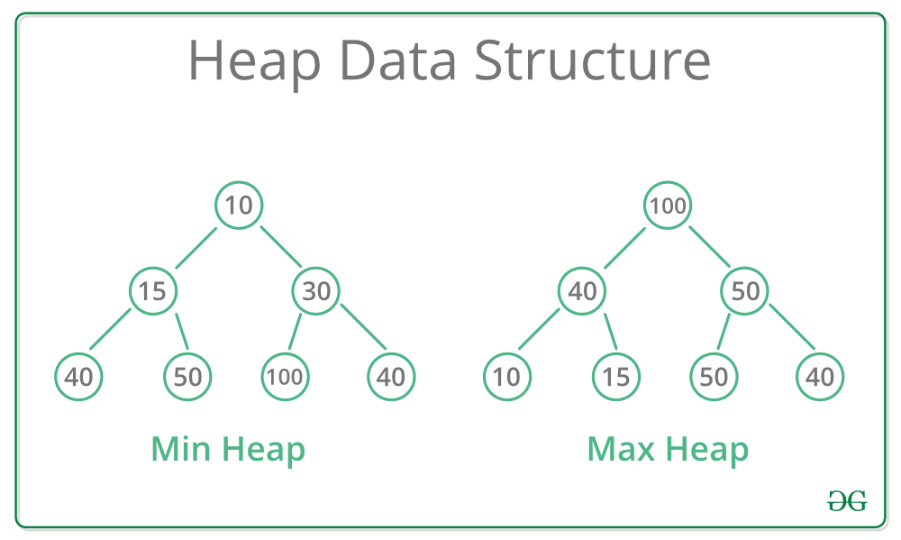

Slide 49
Operations on Max Heap
The following operations are performed on a Max heap data structure...
Finding Maximum
Insertion
Deletion
Finding Maximum Value Operation in Max Heap
Finding the node which has maximum value in a max heap is very simple. In a max heap, the root node has the maximum value than all other nodes. So, directly we can display root node value as the maximum value in max heap.

Slide 50
Insertion Operation in Max Heap
First, we have to insert the element in such a way that the property of the complete binary tree must be maintained.
Secondly, the value of the parent node should be greater than the either of its child.
Insertion Operation in max heap is performed as follows...
Step 1 - Insert the newNode as last leaf from left to right.
Step 2 - Compare newNode value with its Parent node.
Step 3 - If newNode value is greater than its parent, then swap both of them.
Step 4 - Repeat step 2 and step 3 until newNode value is less than its parent node (or) newNode reaches to root.

Slide 51

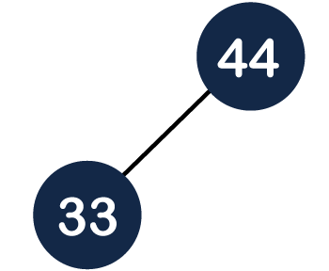
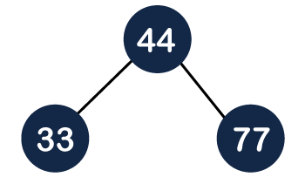
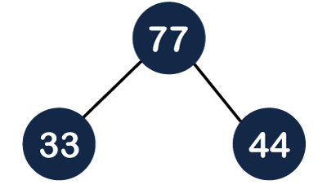
Insertion in the Heap tree 44, 33, 77, 11, 55, 88, 66

Slide 52
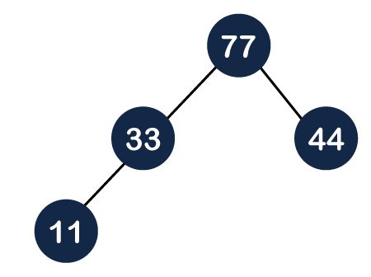
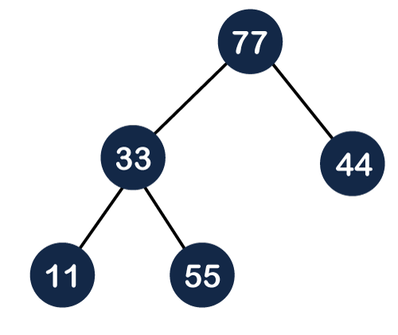

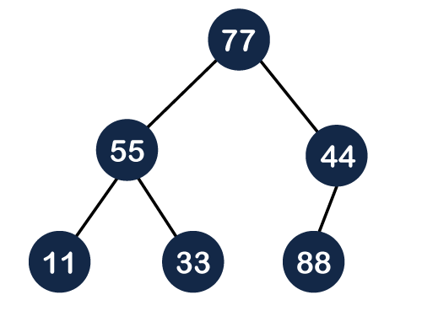
88
88
44
44
66

Slide 53
Deletion Operation in Max Heap
In a max heap, deleting the last node is very simple as it does not disturb max heap properties.
Deleting root node from a max heap is little difficult as it disturbs the max heap properties. We use the following steps to delete the root node from a max heap...
Step 1 - Swap the root node with last node in max heap
Step 2 - Delete last node.
Step 3 - Now, compare root value with its left child value.
Step 4 - If root value is smaller than its left child, then compare left child with its right sibling. Else goto Step 6
Step 5 - If left child value is larger than its right sibling, then swap root with left child otherwise swap root with its right child.
Step 6 - If root value is larger than its left child, then compare root value with its right child value.
Step 7 - If root value is smaller than its right child, then swap root with right child otherwise stop the process.
Step 8 - Repeat the same until root node fixes at its exact position.

Slide 54
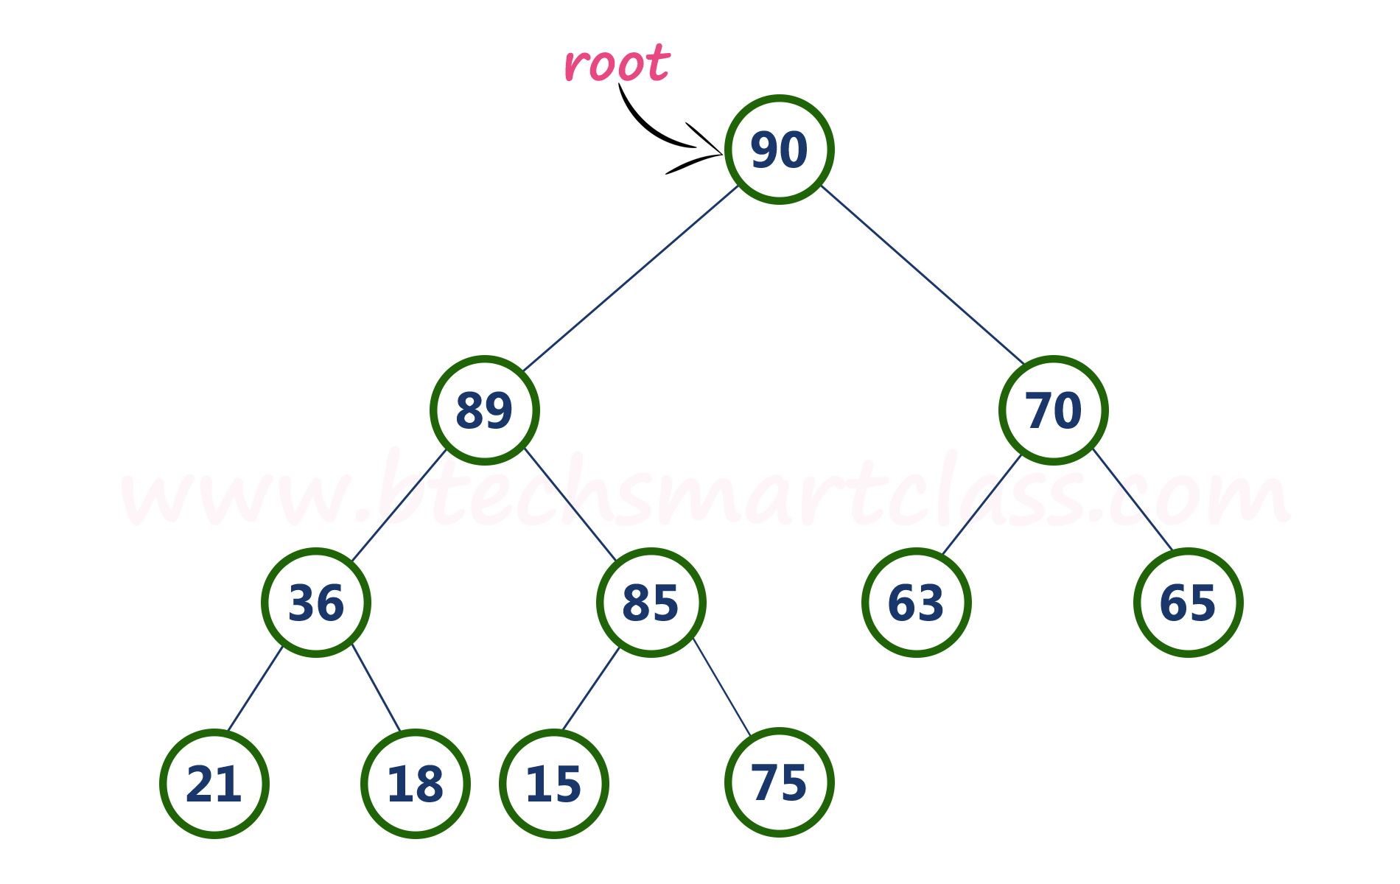
Delete root node 90

Slide 55
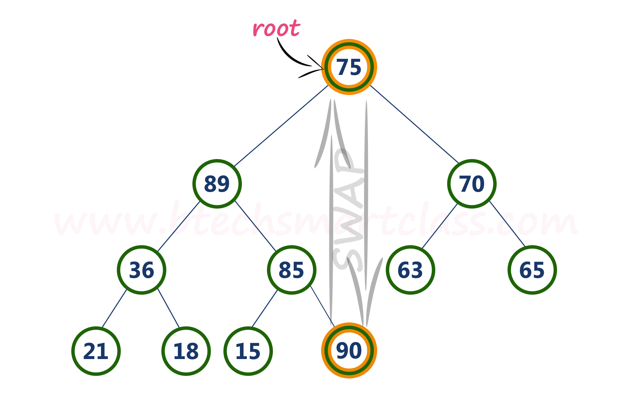
Swap root node 90 with last node 75

Slide 56
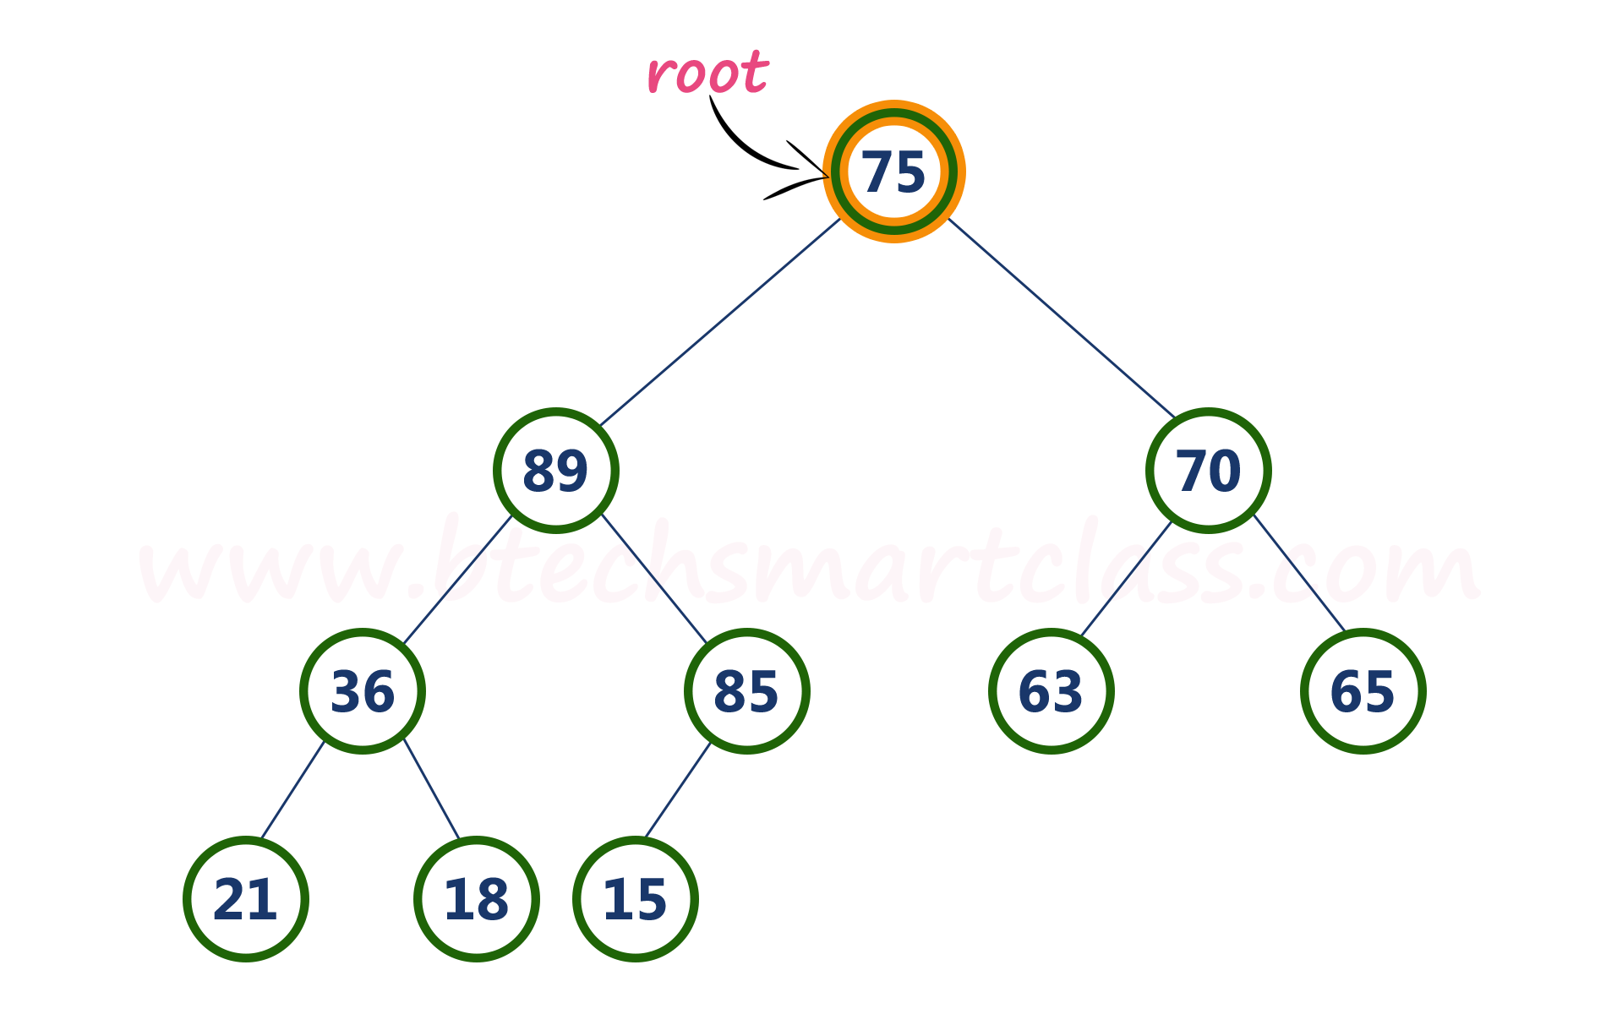
Delete last node. Here the last node is 90. After deleting node with value 90 from heap, max heap is as follows...

Slide 57
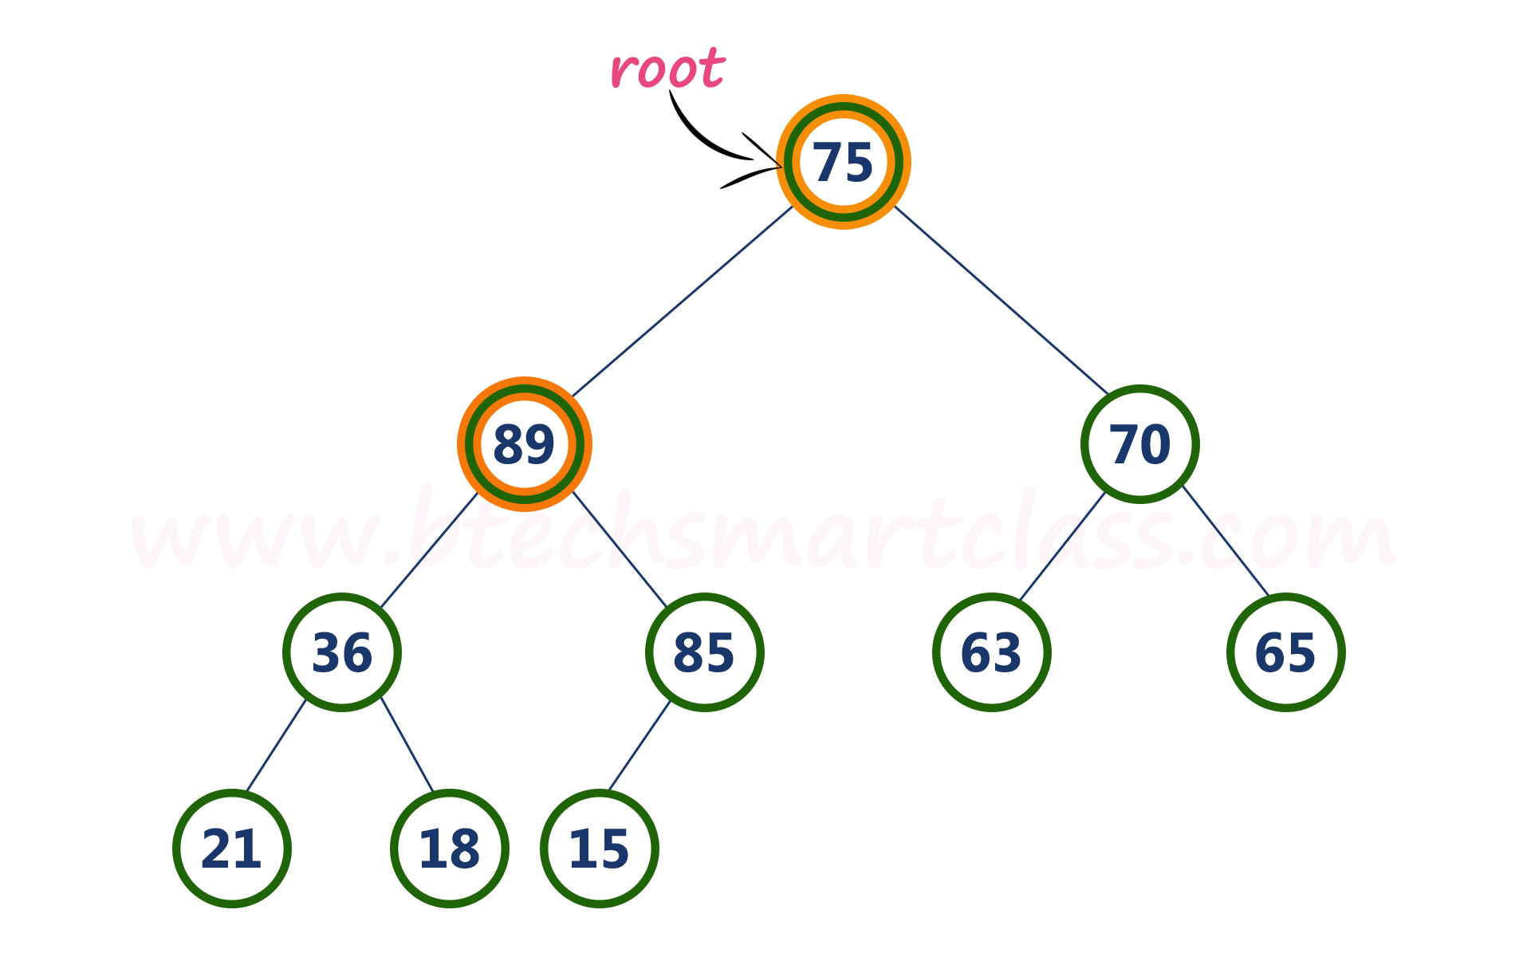
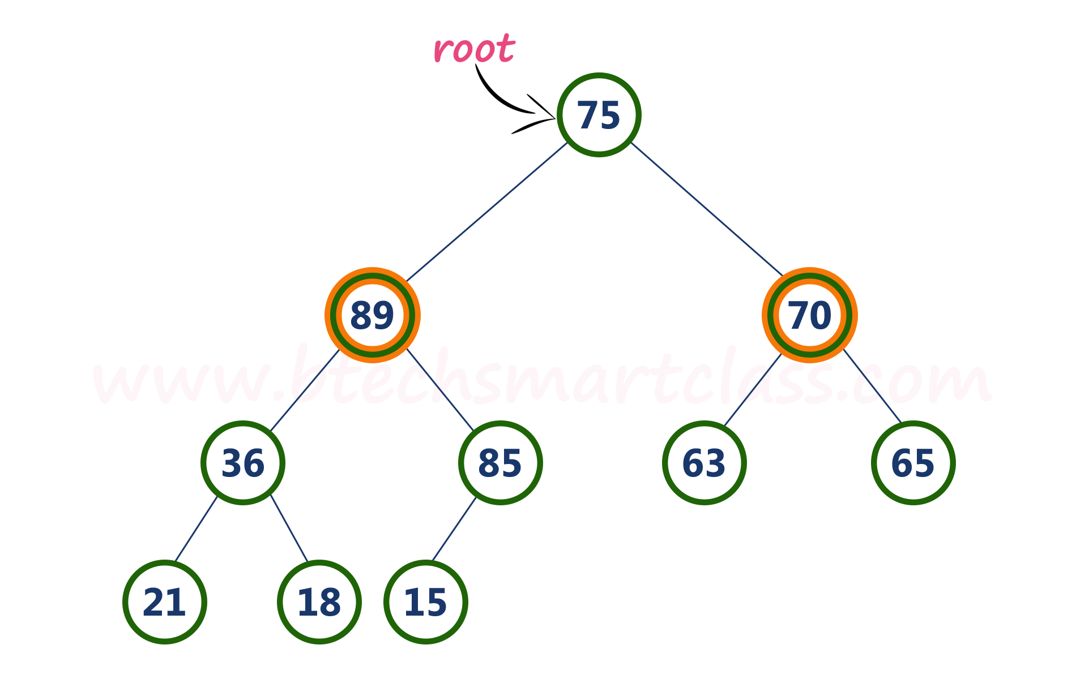
Here, root value (75) is smaller than its left child value (89). So, compare left child (89) with its right sibling (70).
Compare root node (75) with its left child (89).

Slide 58
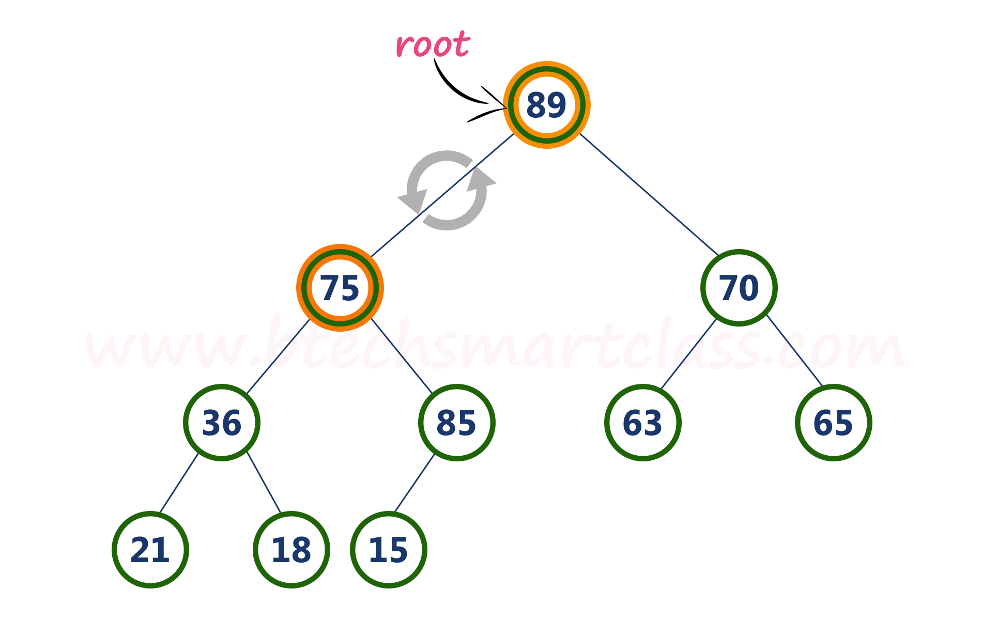
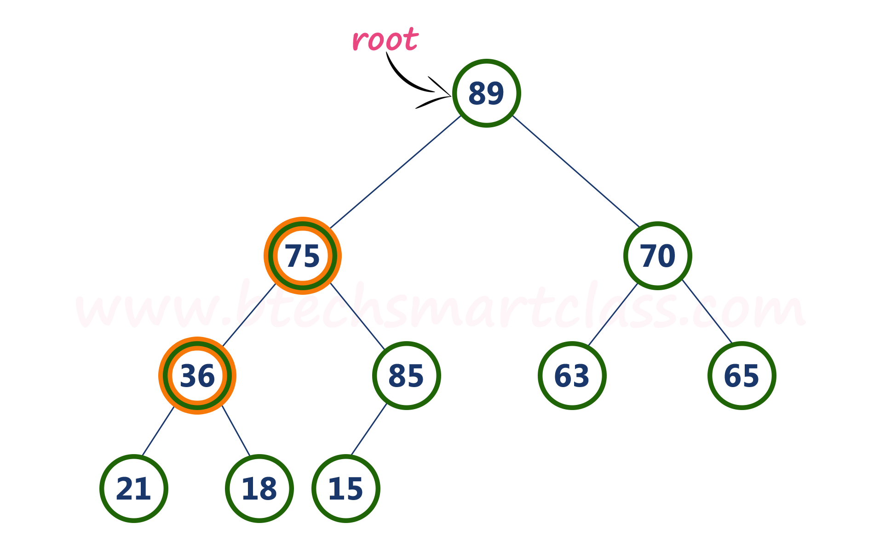
Here, left child value (89) is larger than its right sibling (70), So, swap root (75) with left child (89).
Now, again compare 75 with its left child (36).

Slide 59
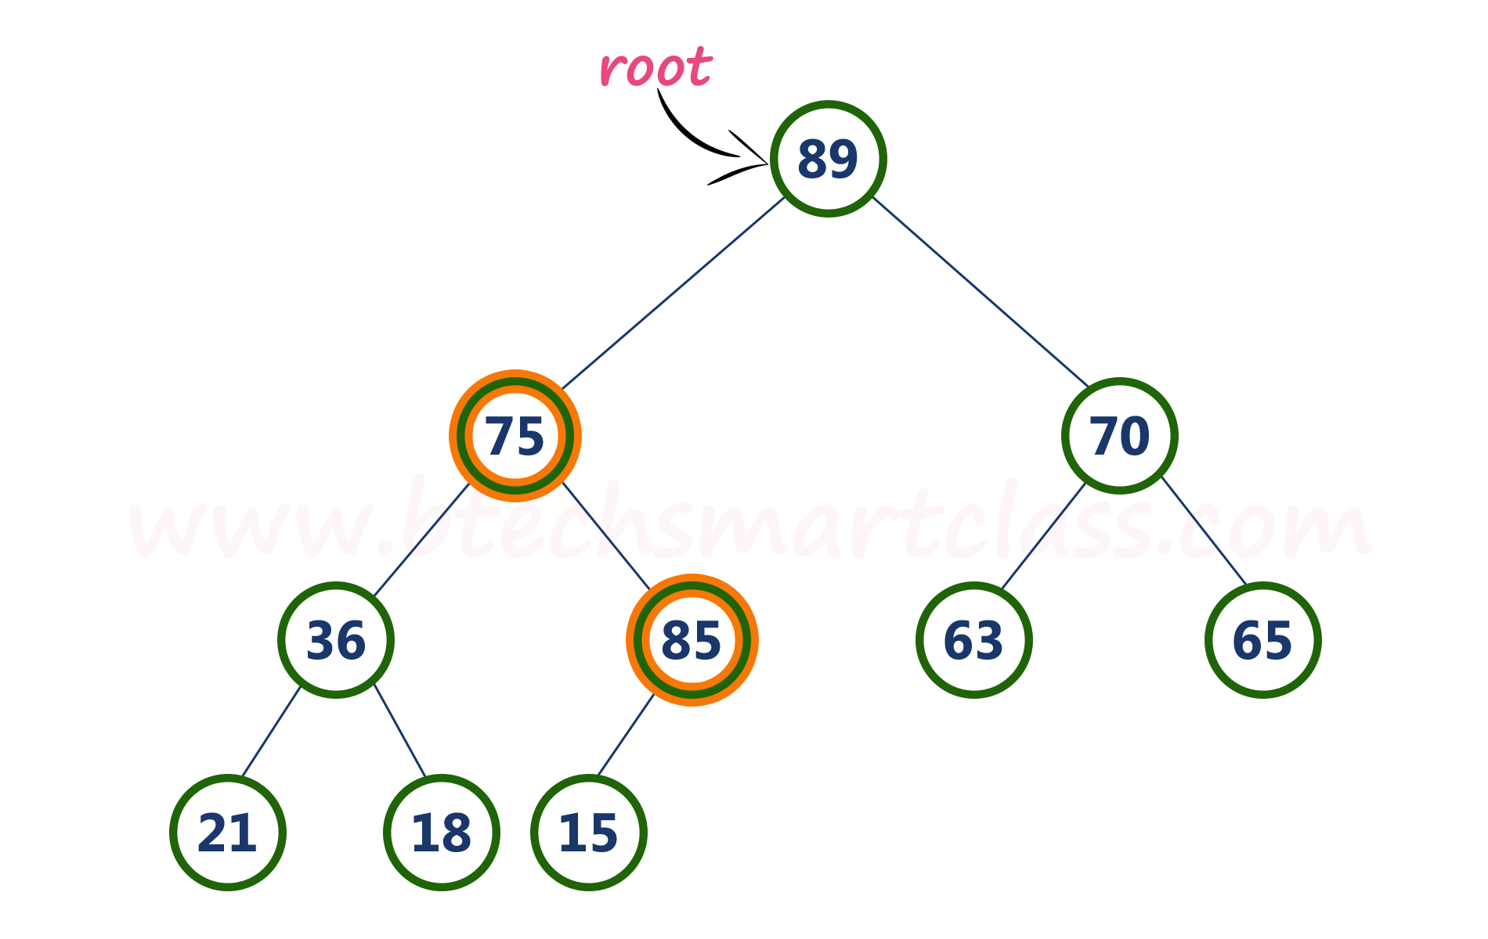

Here, node with value 75 is larger than its left child. So, we compare node 75 with its right child 85.
Here, node with value 75 is smaller than its right child (85). So, we swap both of them. After swapping max heap is as above.

Slide 60
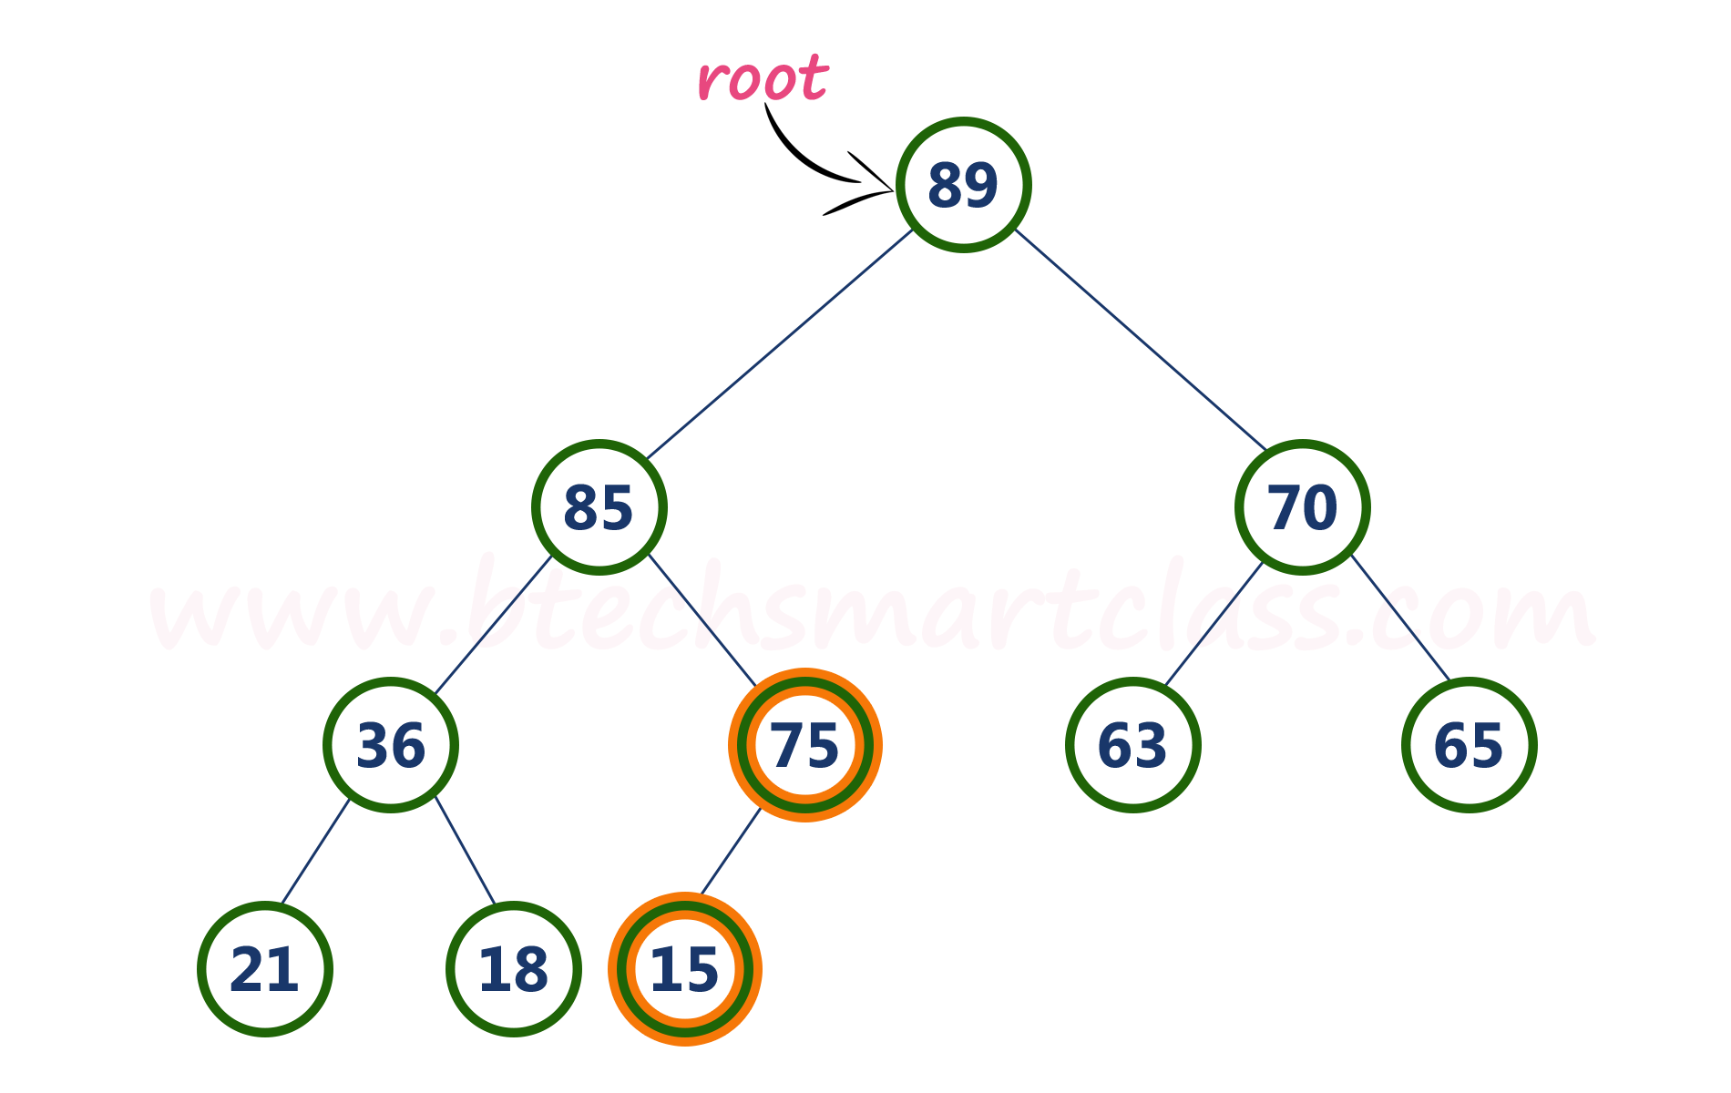
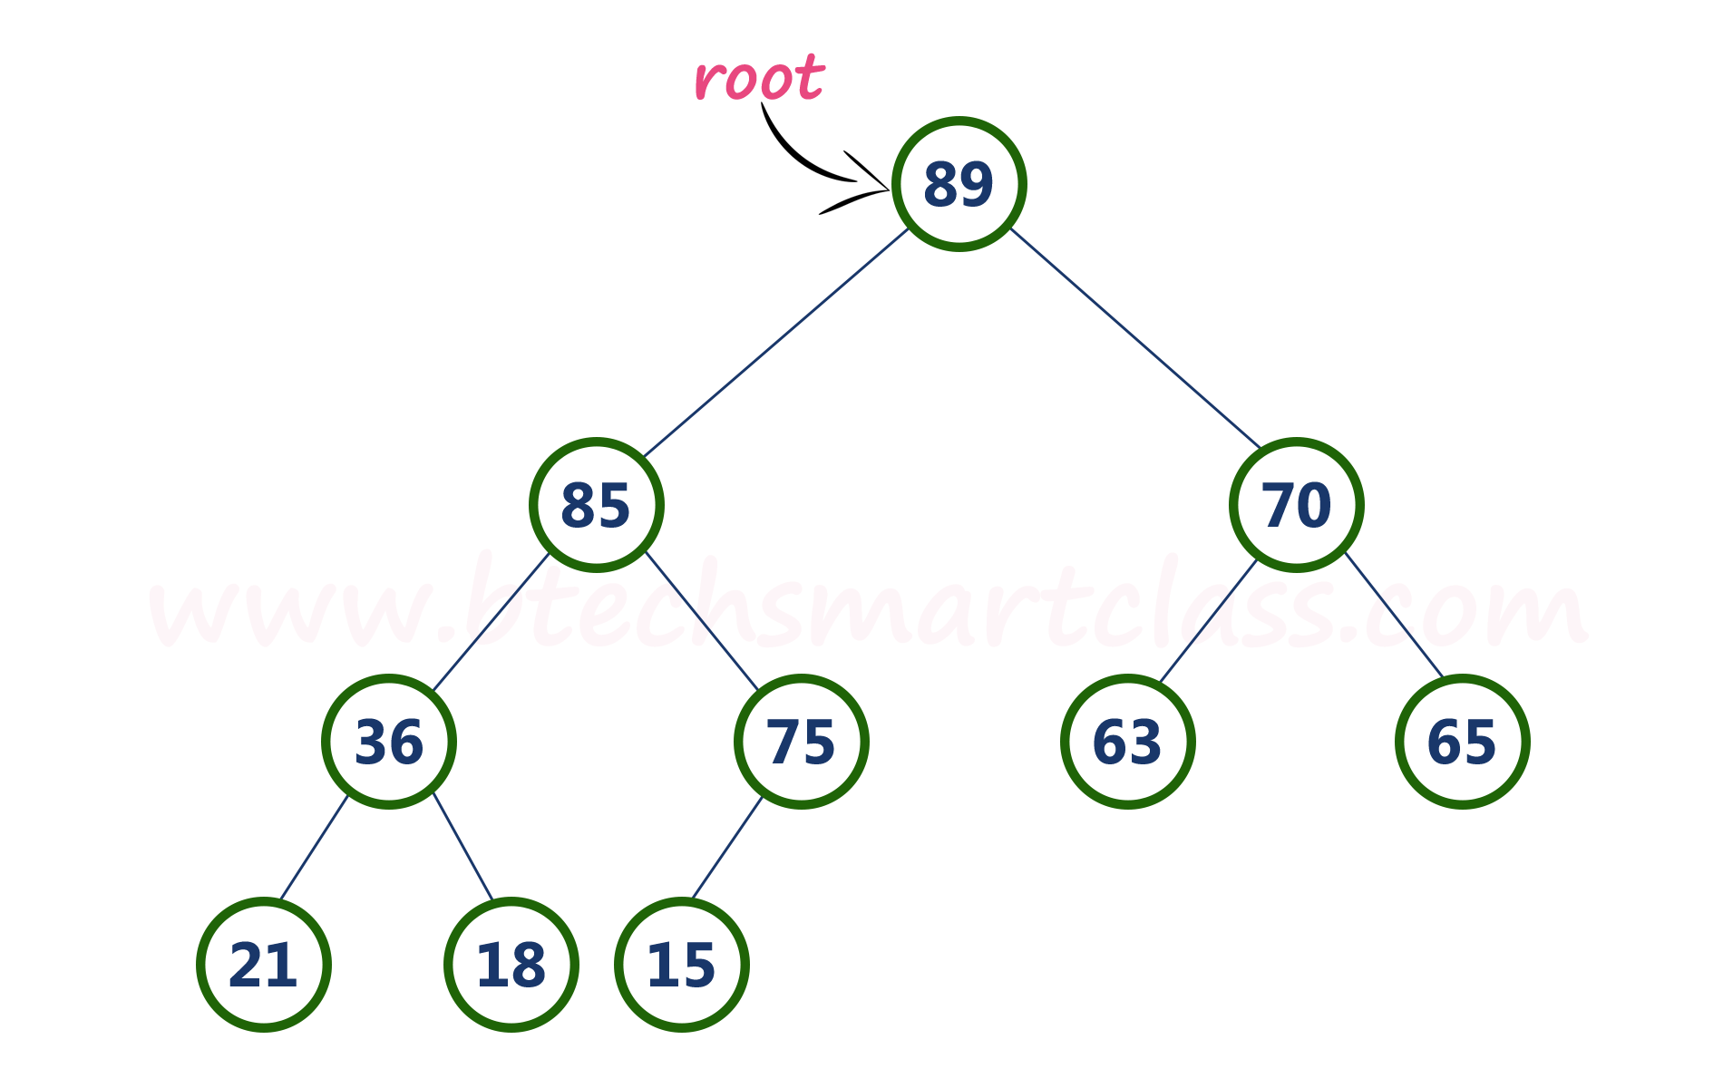
Now, compare node with value 75 with its left child (15).
Here, node with value 75 is larger than its left child (15) and it does not have right child. So we stop the process.
Final tree

Slide 61
Applications of Binary Heaps
Binary heaps are used in a famous sorting algorithm known as Heap sort.
Binary heaps are also the main reason of implementing priority queues, as because of them the several priority queue operations like add(), remove() etc gets a time complexity of O(n).
They are also the most preferred choice for solving Kth smallest / Kth Largest element questions.
Time complexity of Heap
Insertion: O(log N)
Deletion: O (log N)
Find min/max element: O(1)

Slide 62
Priority queue using heap
Priority Queue is an extension of the queue with the following properties:
Every item has a priority associated with it.
An element with high priority is dequeued before an element with low priority.
If two elements have the same priority, they are served according to their order in the queue.
I.e Priority queue is a type of queue in which every element has a key associated to it and the queue returns the element according to these keys, unlike the traditional queue which works on first come first serve basis.

Slide 63
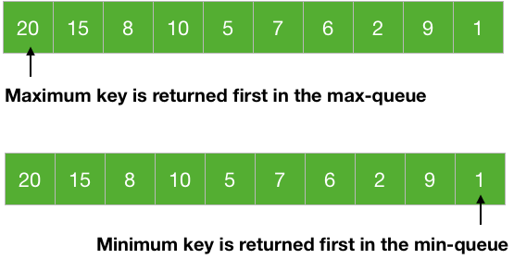
Priority queue using heap
a max-priority queue returns the element with maximum key first whereas, a min-priority queue returns the element with the smallest key first.

Slide 64
Priority queue using heap
Priority queues are used in many algorithms like Huffman Codes, Prim's algorithm, etc. It is also used in scheduling processes for a computer, etc.
Heaps are great for implementing a priority queue because of the largest and smallest element at the root of the tree for a max-heap and a min-heap respectively. We use a max-heap for a max-priority queue and a min-heap for a min-priority queue.

Slide 65
Operations on priority queue
There are mainly 4 operations we want from a priority queue:
1. Insert → To insert a new element in the queue.
2. Maximum/Minimum → To get the maximum and the minimum element from the max-priority queue and min-priority queue respectively.
3. Extract Maximum/Minimum → To remove and return the maximum and the minimum element from the max-priority queue and min-priority queue respectively.
4. Increase/Decrease key → To increase or decrease key of any element in the queue.

Slide 66
Operations on priority queue
A priority queue stores its data in a specific order according to the keys of the elements. So, inserting a new data must go in a place according to the specified order. This is what the insert operation does.
The entire point of the priority queue is to get the data according to the key of the data and the Maximum/Minimum and Extract Maximum/Minimum does this for us.
Situation: we need to change the key of an element, so Increase/Decrease key is used to do that.

Slide 67
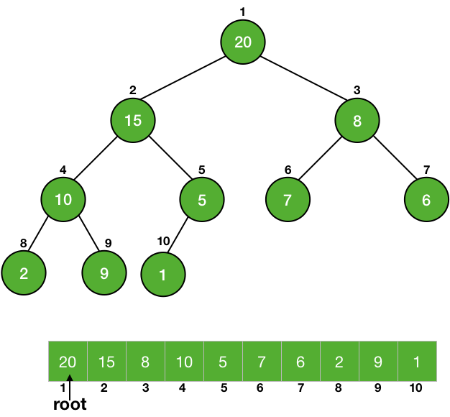
Operations on priority queue-Maximum/Minimum
We know that the maximum (or minimum) element of a priority queue is at the root of the max-heap (or min-heap). So, we just need to return the element at the root of the heap Returning an element from an array is a constant time taking process, so it is a Θ(1) process..

Slide 68
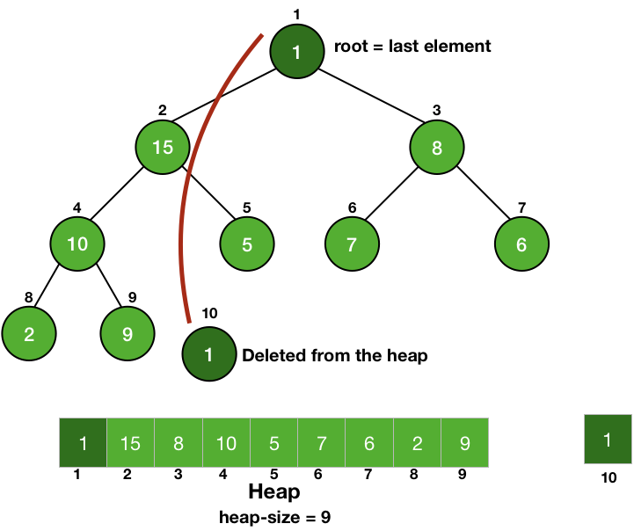
Operations on priority queue-Extract Maximum/Minimum
This is like the pop of a queue, we return the element as well as delete it from the heap.
So, we have to return and delete the root of a heap.
Firstly, we store the value of the root in a variable to return it later from the function and then we just make the root equal to the last element of the heap.
Now the root is equal to the last element of the heap, we delete the last element easily by reducing the size of the heap by 1.

Slide 69
Operations on priority queue-Extract Maximum/Minimum
Doing this, we have disturbed the heap property of the root but we have not touched any of its children, so they are still heaps. So, we can call Heapify on the root to make the tree a heap again.
All the steps are constant time taking process except the Heapify operation, it will take O(lgn) time and thus the xtract Maximum/Minimum is going to take O(lgn) time.

Slide 70
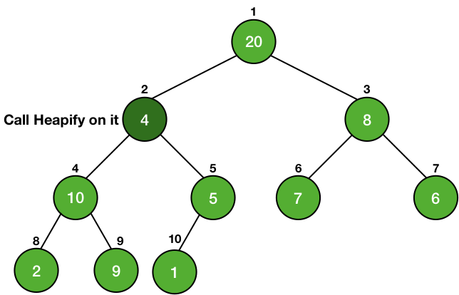
Operations on priority queue-Increase and decrease key
Whenever we change the key of an element, it must change its position to go in a place of correct order according to the new key.
If the heap is a max-heap and we are decreasing the key, then we just need to check if the key became smaller than any of its children or not.
If the new key is smaller than any of its children, then it is violating the heap property, so we will call Heapify on it.

Slide 71
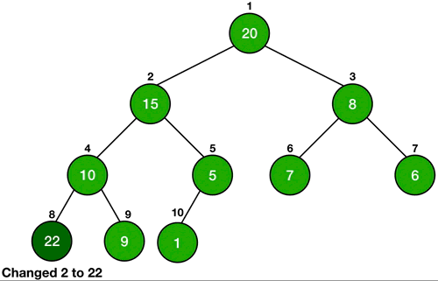
Operations on priority queue-Increase and decrease key
In the case of increasing the key of an element in a max-heap, we might make it greater than the key of its parent and thus violating the heap property.
In this case, we swap the values of the parent and the node and this is done until the parent of the node becomes greater than the node itself.

Slide 72
Operations on priority queue-Insert
The insert operation inserts a new element in the correct order according to its key. We just insert a new element at the last of the heap and increase the heap size by 1.
Since it is the last element, so we first give a very large value (infinity) in the case of min-heap and a very less value (-inf) in the case of max-heap. Then we just change the key of the element by using the Increase/Decrease key operation.
ll the steps are constant time taking steps, except the Increase/Decrease key. So it will also take O(lgn) time.

